Slide 1


Slide 2
Organized by: ISSA Section Machine and System Safety
1st issue: September 2021 – September 2023
2nd issue: started October 1st, 2024, deadline for submissions: August 30th, 2025
Time frame: launched every three years
https://www.safe-machines-at-work.org/safety-award-2025

Slide 3
Background: There are still too many accidents in relation with machines worldwide, which are causing human suffering and entailing substantial costs for the social insurance systems.
Aim: The Section intends to motivate machine manufacturers to give machine safety and ergonomics a higher priority.
https://www.safe-machines-at-work.org/safety-award-2025

Slide 4
Award:
The winners receive a trophy, a certificate and the Safety Award’s digital logo which may be used for marketing purposes.
The award carries no prize money.
To make good solutions more visible worldwide, the Section Machine and System Safety will take care of opportunities to present the winners at congresses and in publications
https://www.safe-machines-at-work.org/safety-award-2025

Slide 5
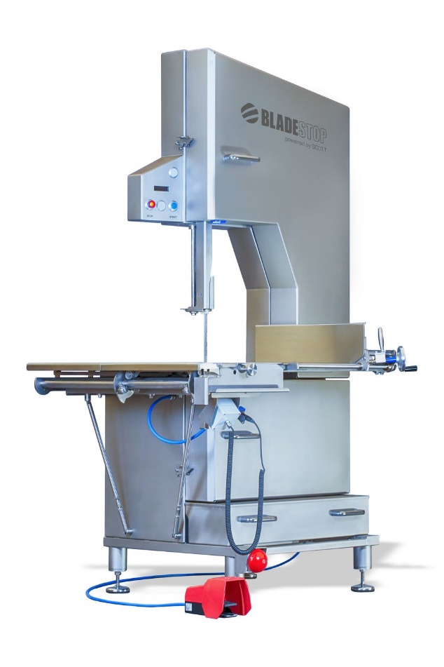
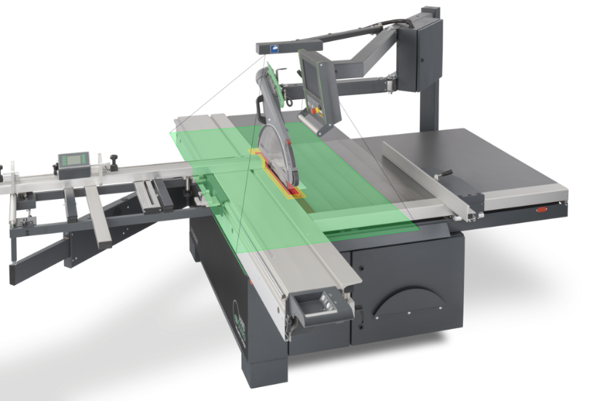
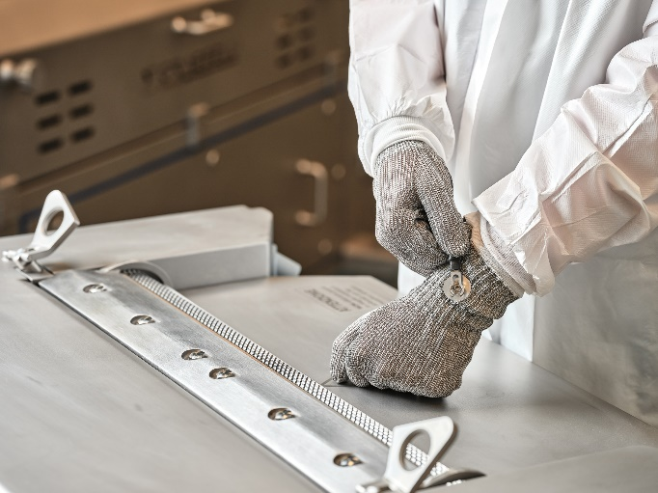
The winners 2023
Altendorf GmbH: Hand Guard™ System
Grasselli Spa: Skinner Safety System
Scott Automation & Robotics: BladeStop™ Safety Bandsaw

Slide 6
How to join:
Fill in the questionnaire on our website and send it to us
https://www.safe-machines-at-work.org/safety-award-2025
An international jury will evaluate all submissions according to fixed evaluation criteria.
https://www.safe-machines-at-work.org/safety-award-2025

Slide 7
We are looking forward to your submissions!
If you have any questions or remarks, please contact:
Silke Scholl-Scheiba
ISSA Section Machine and System Safety
scholl@ivss.org

